Slide 1

Presented by
MD.Shajamal
MD.Imrul Kayes
Kazi Nihat
Course : URC-1103
Group : 10
Section : G

Slide 2
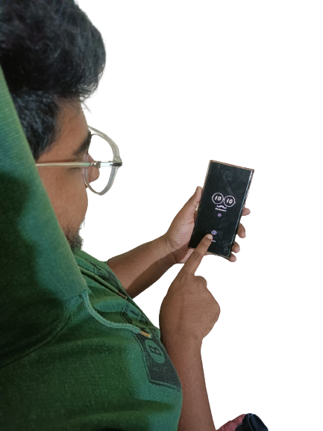
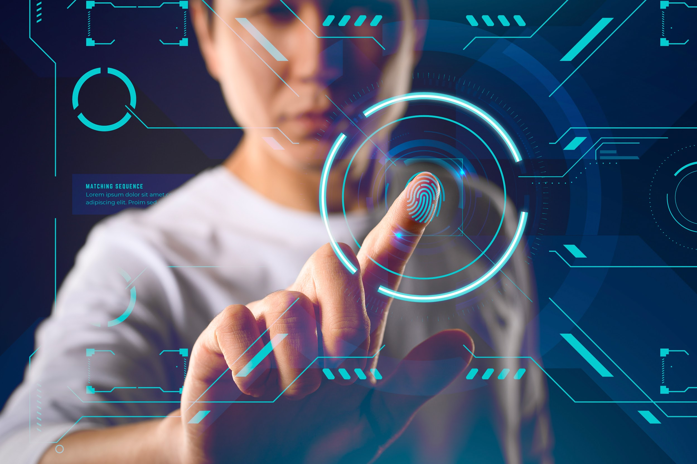
Better than password
Secure personal information

Slide 3
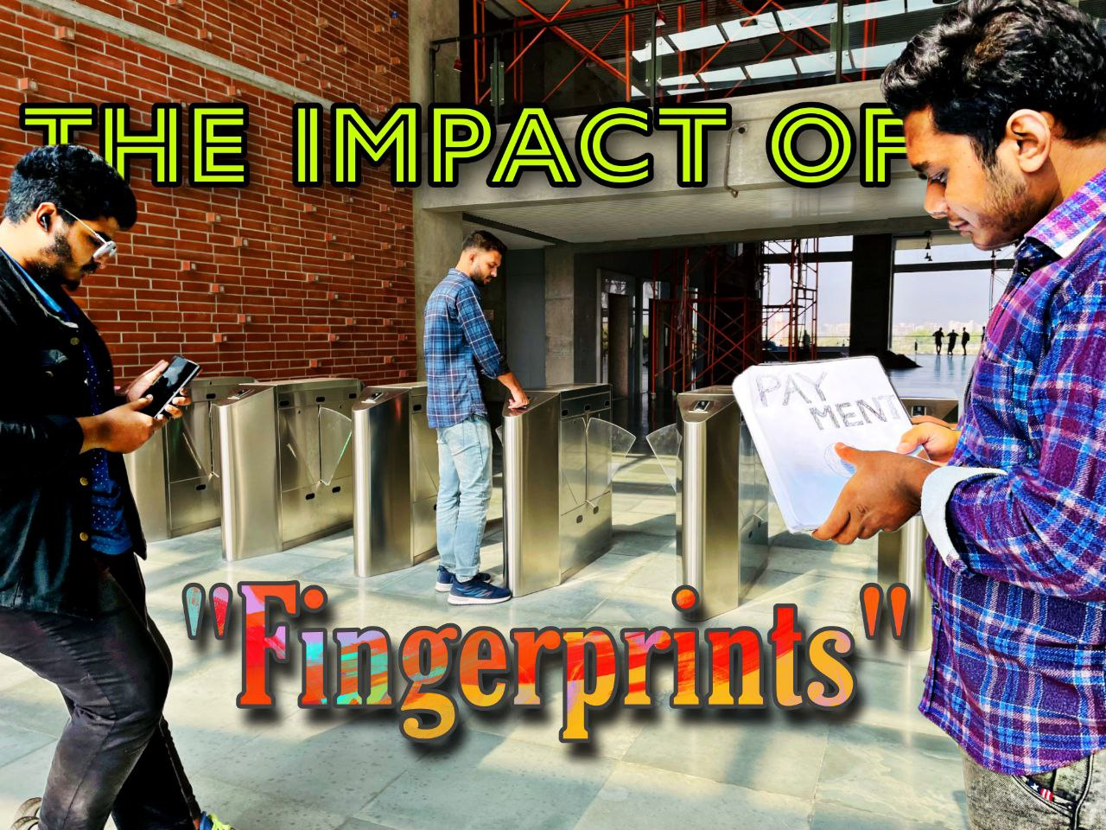

Slide 4
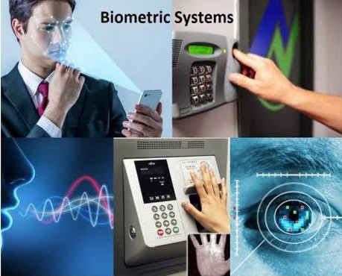
BIOMATRICS

Slide 5

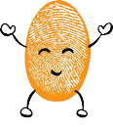
yes
Yes, I have an unique fingerprint
Your fingerprints are unique.
Yes, I have also an unique fingerprint
A form of identification.

Slide 6
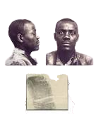
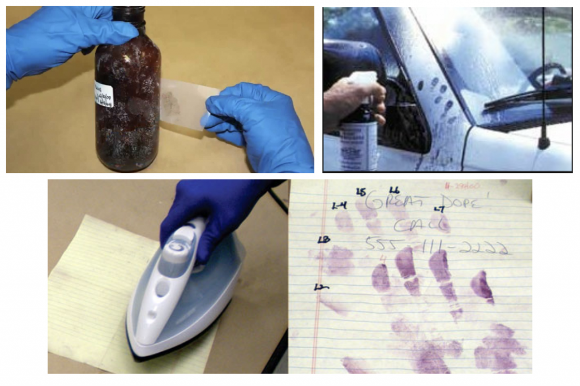
First case solving by fingerprint

Slide 7
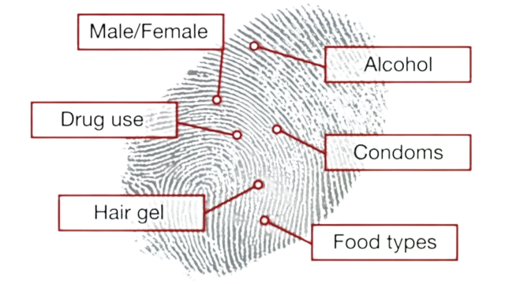
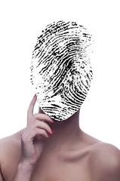
Identifing someone
A person’s age
Male or Female
Food chain

Slide 8
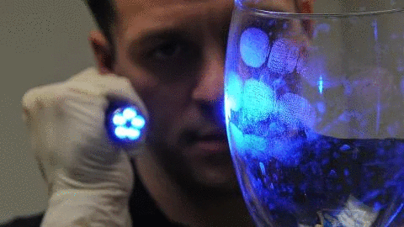
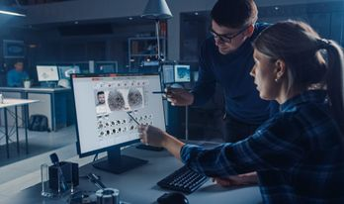
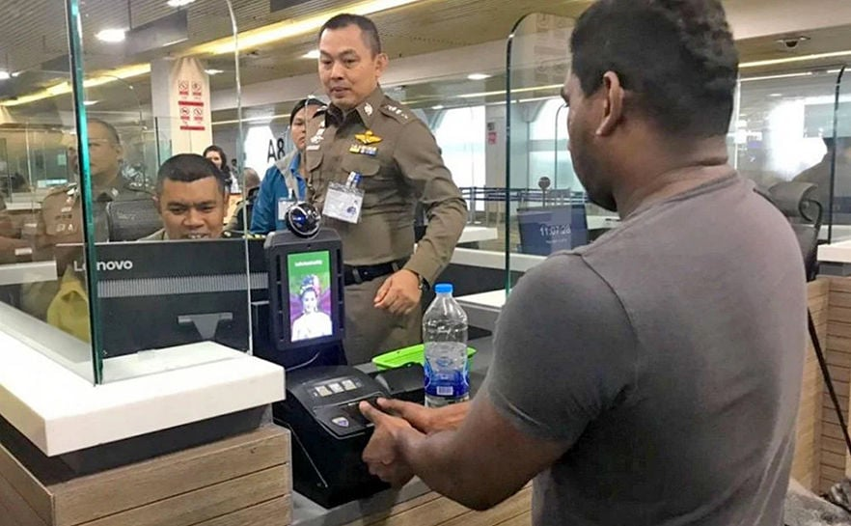
CRIME INVESTIGATION
Identify Criminal
Automated Fingerprint Identification
Airport security

Slide 9
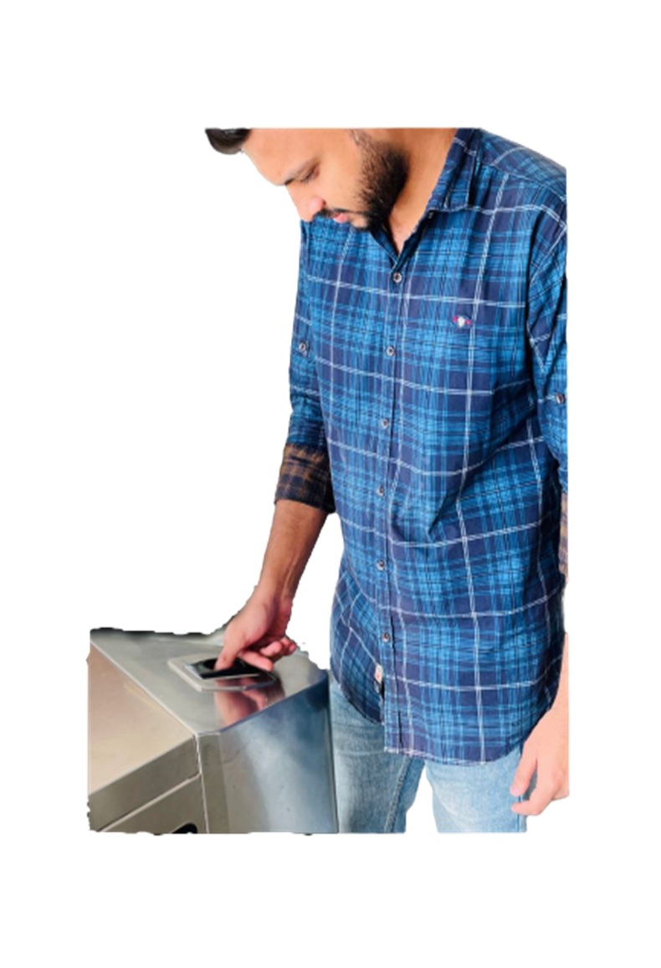
PRIVACY AND SECURITY
Prevent unwanted entry
Secure private file

Slide 10
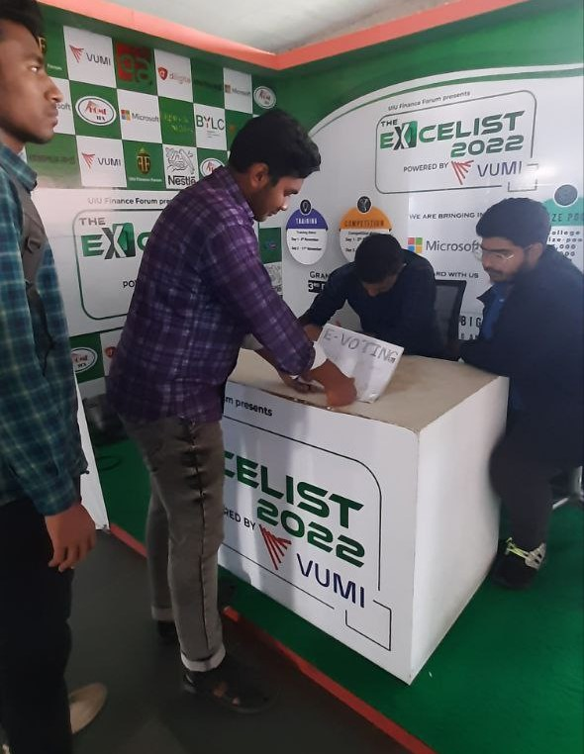
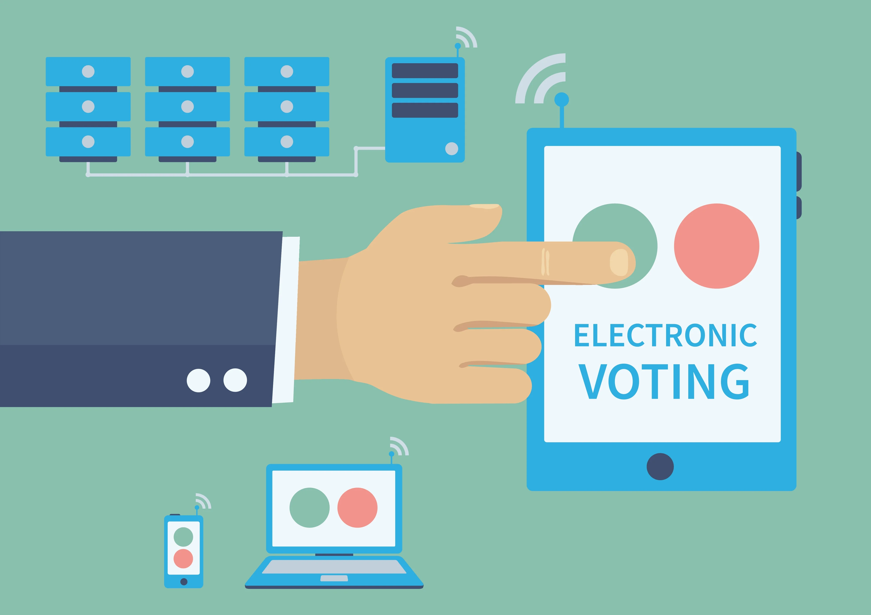
Electronic Voting
Individual secure voting system
E-Voting

Slide 11
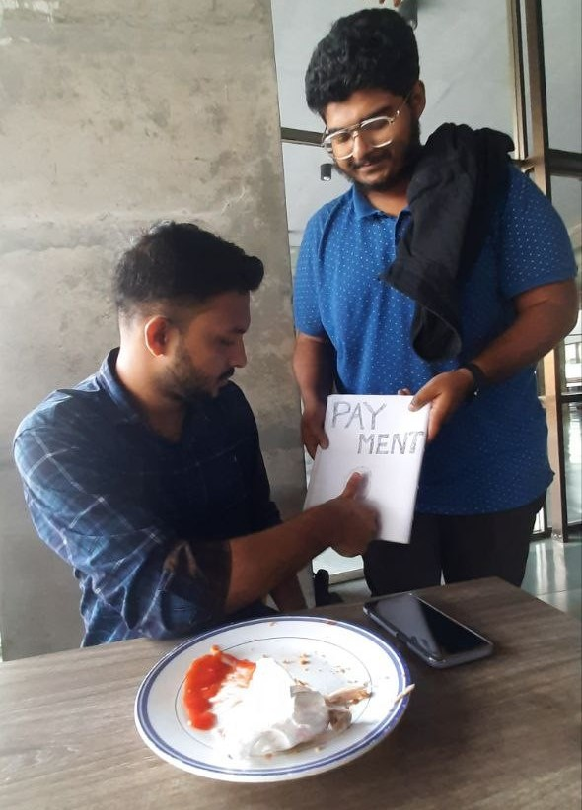
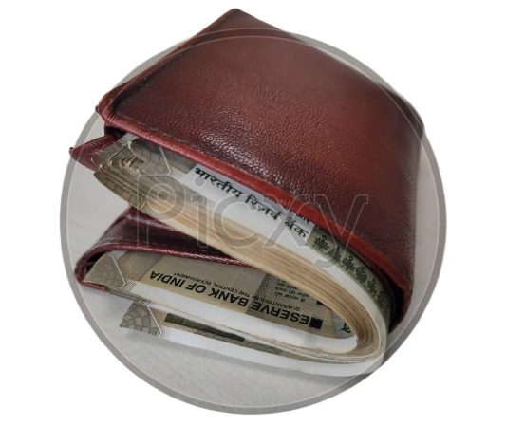
EVALUATION

Slide 12
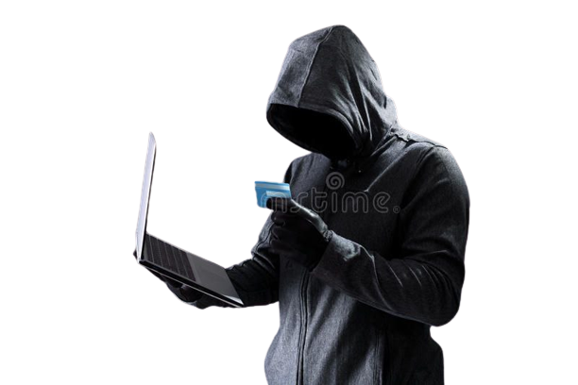
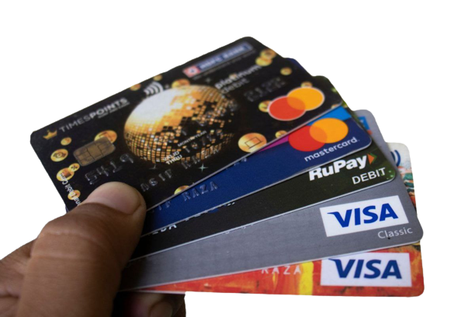
Caring Cards

Slide 13
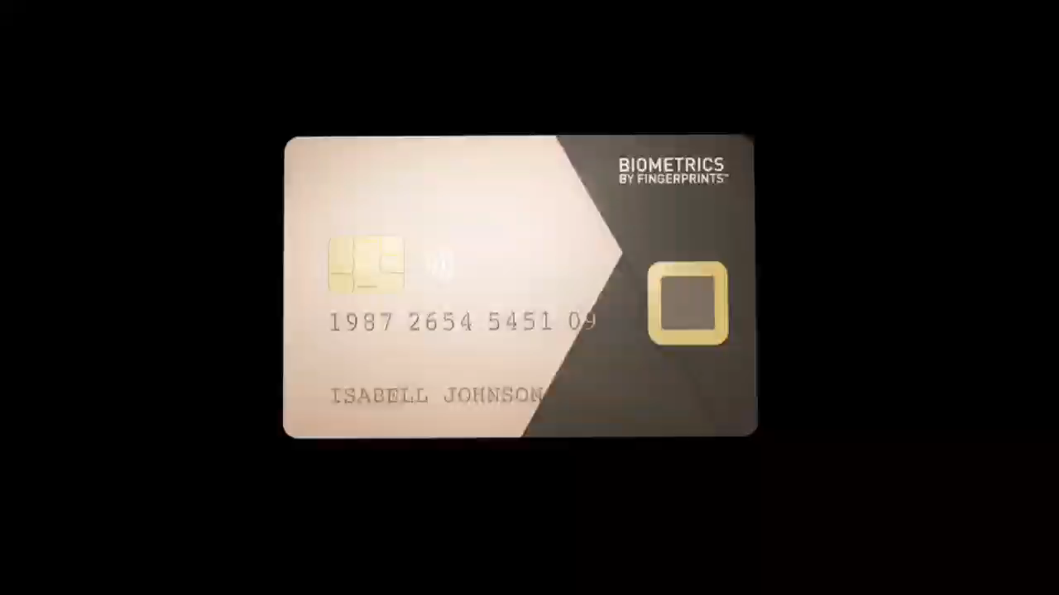

Slide 14
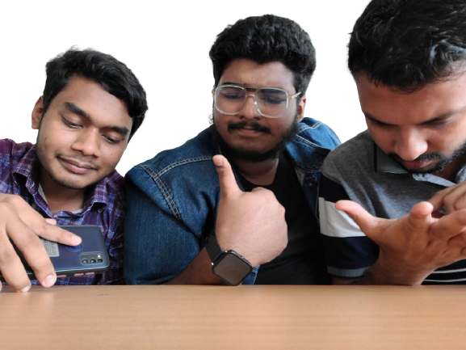
Now, it`s your turn to ask

